Slide 1
Deep Learning in Autonomous Driving
Direct Perception Approach
Timo Bergerbusch
Seminar
am Lehrstuhl für Software Engineering
RWTH Aachen

Slide 2
Overview
1.
(Convolutional) Neuronal Nets
2.
Current Approaches
3.
Direct Perception Approach
4.
Deep Learning Languages
5.
Training and Test
6.
Summary

Slide 3
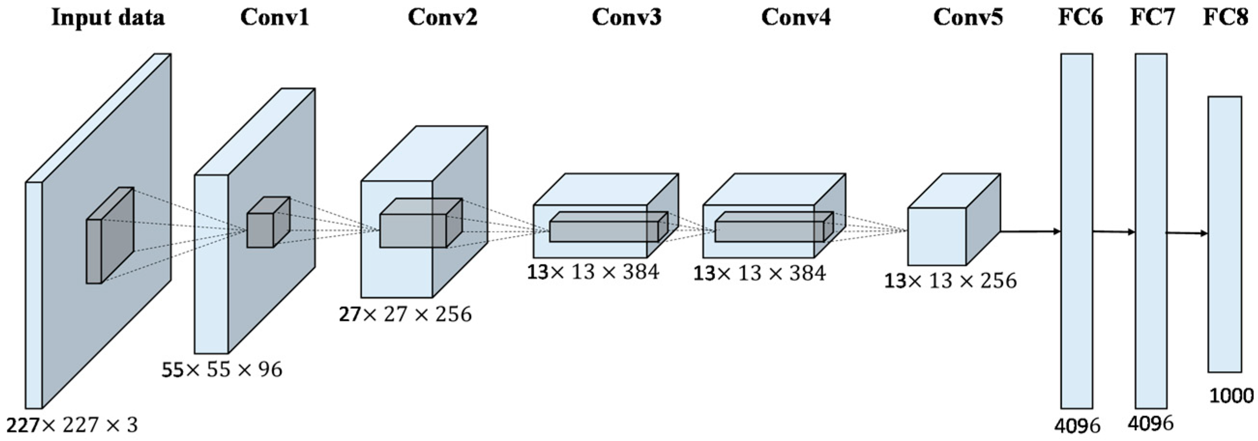
(Convolution) Neural Nets
neural net: 3 layer-types
convolutional:
multiple Hidden-Layer (deep)
different layers: fully-connected, convolution, pooling, ReLU
AlexNet
…
Input
hidden
output
Notes:
Neural nets:
Simple principle: neurons with weighted sum – bias
Organized in layers
Training = adjusting the weights and biases
Conv. NN:
More than 1 hidden layer
Different layer types:
Fully-connected
Convolution: feature detection considering scale, rotate
Pooling: reduction of input
ReLU: mathmatical normalization
AlexNet: used in the approaches given

Slide 4
Overview
1.
(Convolutional) Neuronal Nets
2.
Current Approaches
3.
Direct Perception Approach
4.
Deep Learning Languages
5.
Training and Test
6.
Summary

Slide 5
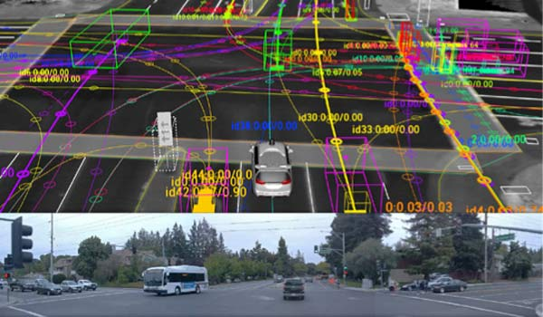
Current Approaches: mediated perception
multi-components
internal 3D-model
problems:
complex
irrelevant/redundant data
Components still research topics themselves
Mögliche eigenständige Einheiten
Abrasion-detection
Pedestrian-detection
Distance-measures
Lane-detection
Vehicle-detection
Veloctiy-measures
Notes:
Mediated perception:
Mutli component complex system
Internal 3D model
Problems as given
=> Reasonable and sturdy approach but lacks flex. and efficiency

Slide 6
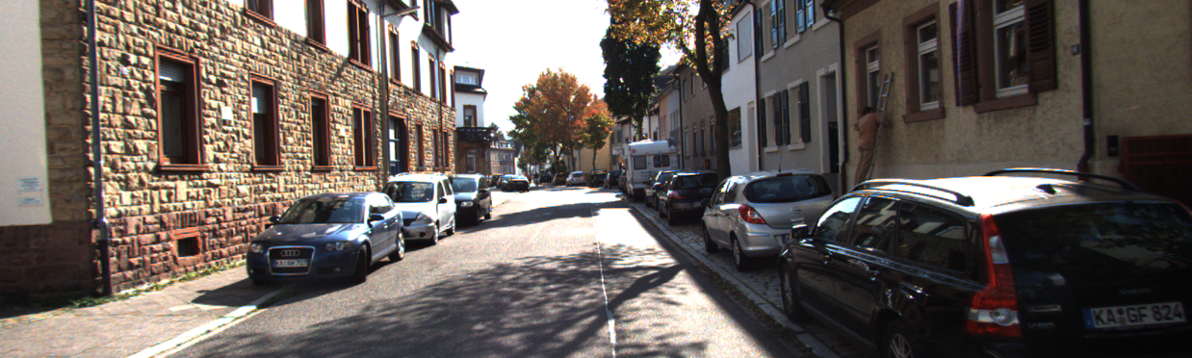
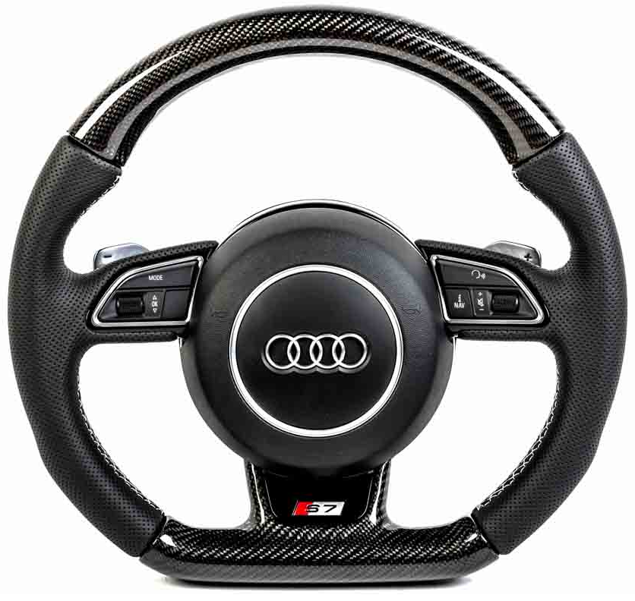
Current Approaches: Behavior Reflex
direct mapping of:
Image-input
steering angle
good for simple, bad very poor for complex tasks
Notes:
Behavior reflex:
Map input to angle

Slide 7
Overview
1.
(Convolutional) Neuronal Nets
2.
Current Approaches
3.
Direct Perception Approach
4.
Deep Learning Languages
5.
Training and Test
6.
Summary

Slide 8
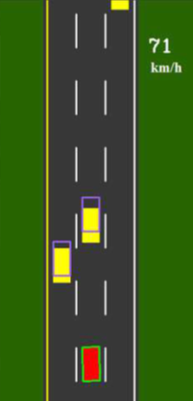
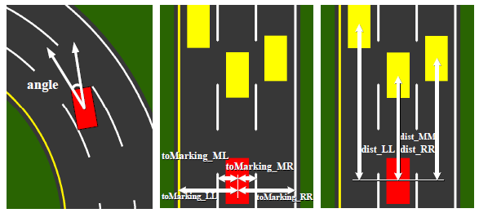
Die Direct Perception
hybrid of: mediated und behavior
13 affordance-values
minimalistic modelling

Slide 9


Die Direct Perception
Highway driving scenarios
distinguish 2 situations:
Inactivity of currently irrelevant values
in lane
on marking
Example:
No cars on „right“ lane
No cars on “left” lane
But: distance to right lane

Slide 10
Overview
1.
(Convolutional) Neuronal Nets
2.
Current Approaches
3.
Direct Perception Approach
4.
Deep Learning Languages
5.
Training and Test
6.
Summary

Slide 11
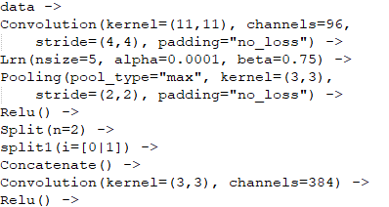
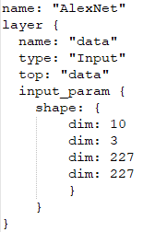
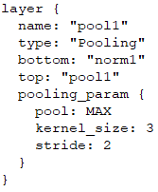
Deep Learning Languages
Different languages to model those CNNs:
CNNArchLang:
part of the MontiCore language family
uses the MxNet framework
Python like Syntax
Caffe:
specialized on modularity, speed and expressiveness
huge community
very verbose through Protocol Buffers

Slide 12
Overview
1.
(Convolutional) Neuronal Nets
2.
Current Approaches
3.
Direct Perception Approach
4.
Deep Learning Languages
5.
Training and Test
6.
Summary

Slide 13
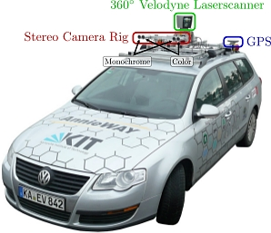
Training
Problem: very specific datasets
TORCS: The Open Racing Car Simulator
KITTI Dataset: 6 hours drive recording
different cameras and views
Additional measurements

Slide 14
Overview
1.
(Convolutional) Neuronal Nets
2.
Current Approaches
3.
Direct Perception Approach
4.
Deep Learning Languages
5.
Training and Test
6.
Summary

Slide 15
Summary
Direct perception:
better than behavior reflex
as good as mediated perception
But: what about more complexity?
CNNArchLang:
simplistic language design (python-like)
elegant definitions of CNNs
through MxNet: SLI and Cluster usage
drawbacks:
no recurrent neural nets
missing set of pre-trained models
documentation
Notes:
Direct Perception:
proven handle highway
Complex tasks?
Signs
Pedestrians
Other faster cars
CNNArch:
Well suited
Highly efficient and scalable (MxNet)
Few minor problems (ok since new)

Slide 16
Fin.
thank your for your attention

